Slide 1
ExoHabitAI
Predicting the Habitability of Exoplanets Using Machine Learning
PRESENTER: THORAM SRI VIDHYA
EMAIL: srividhyathoram@gmail.com
Branch: CSE

Slide 2
Problem Statement
Thousands of exoplanets have been discovered in recent years
Manual habitability assessment is complex and time-consuming
Astronomical datasets are high-dimensional and imbalanced
Need an automated, data-driven system to predict habitability
Goal: Assist astronomers in identifying promising habitable candidates

Slide 3
Objectives
Build a machine learning model to predict exoplanet habitability
Engineer meaningful planetary and stellar features
Handle severe class imbalance in habitable vs non-habitable planets
Improve recall for rare habitable planets
Rank exoplanets based on habitability probability

Slide 4
Dataset Overview
Source: NASA Exoplanet Archive (PSCompPars dataset)
~40,000 exoplanet records with 90+ attributes
Data includes:
Planet radius, mass, density, temperature
Orbital and stellar parameters
Dataset does not contain direct habitability labels

Slide 5
Challenges in raw data
Missing values in critical scientific parameters
Highly imbalanced target distribution
Presence of non-terrestrial planets
Different scales across numerical features
Need for domain-specific feature engineering

Slide 6
Feature Engineering
Created derived scientific features:
Planet Density & Star Luminosity
Habitability Score Index (HSI)
Stellar Compatibility Index (SCI)
One-hot encoded star types (F, G, K, M)
Selected features based on correlation analysis

Slide 7
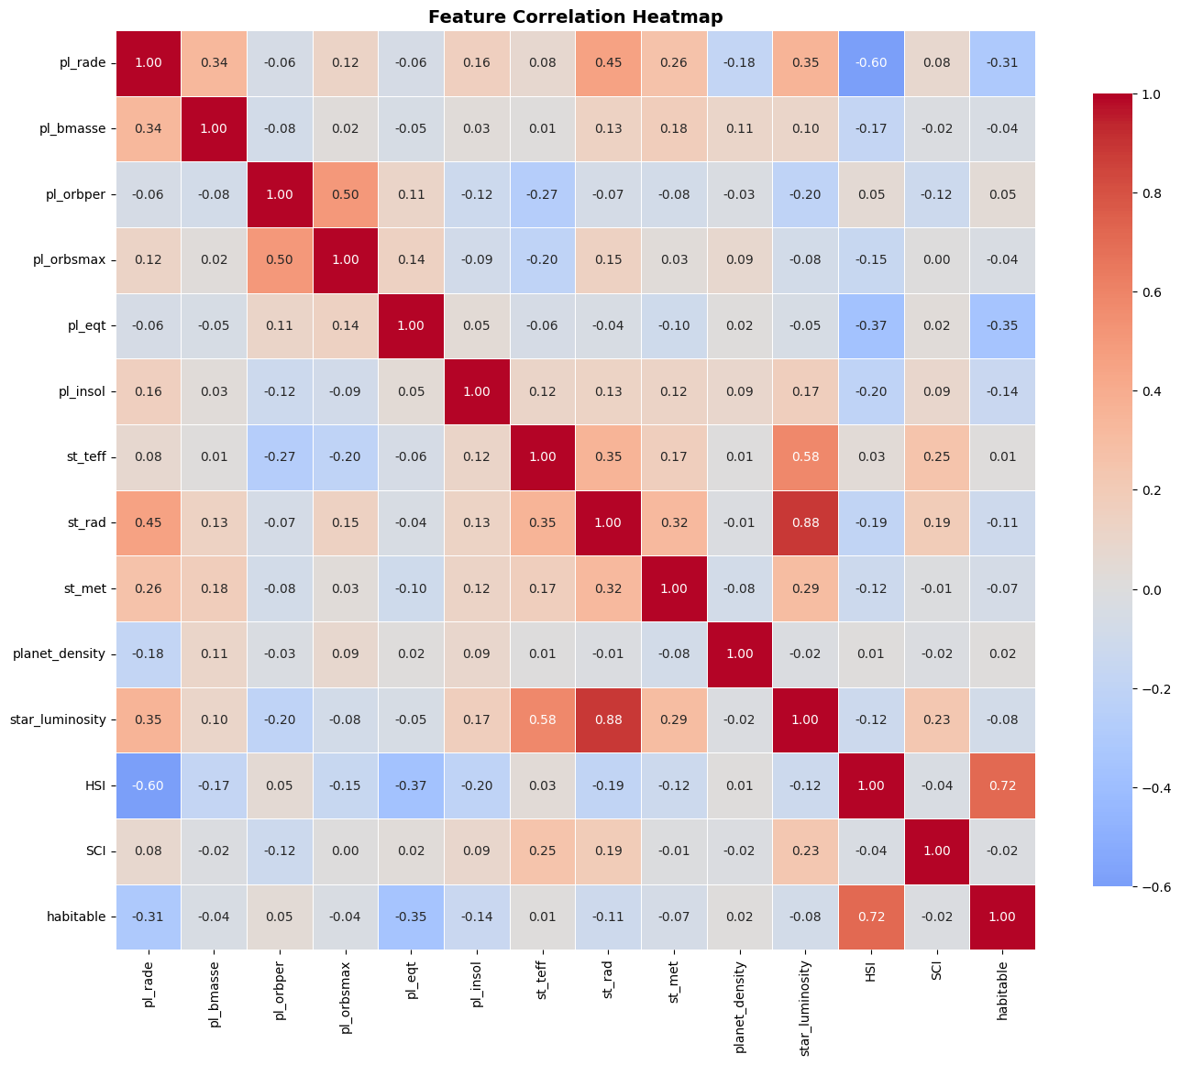
Exploratory Data Analysis (EDA)
Visualized feature distributions and outliers
Correlation heatmap analysis
Observed strong influence of:
Equilibrium temperature
Insolation flux
Identified severe class imbalance

Slide 8
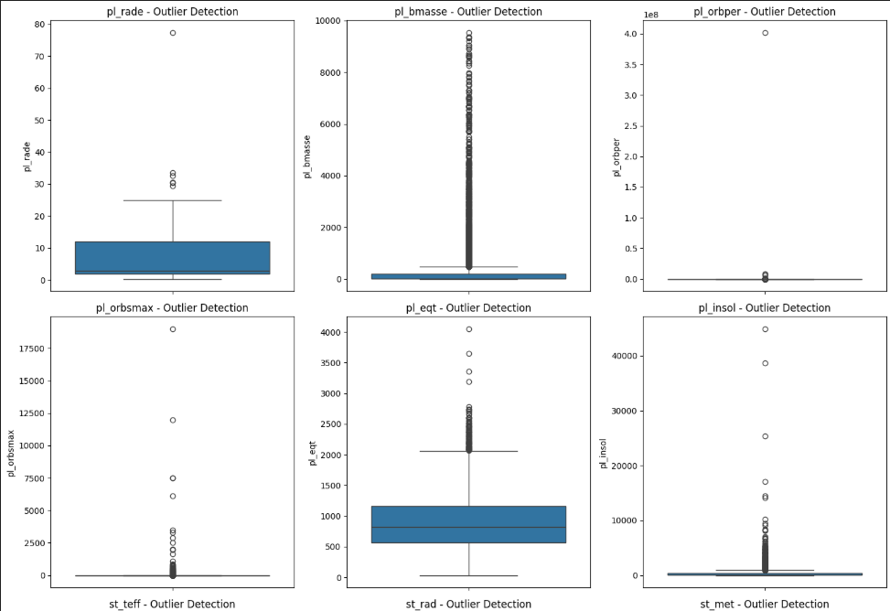
Visualization Techniques
Histograms for key planetary features
Box plots for outlier analysis
Correlation heatmaps
PCA and t-SNE for data visualization

Slide 9
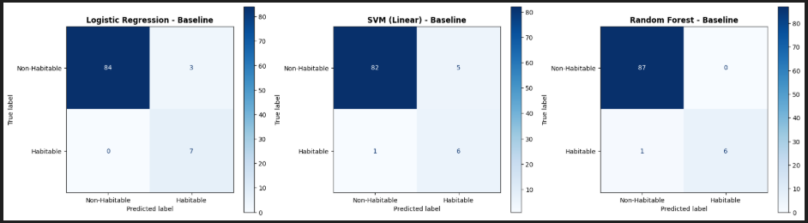
Baseline Models & Comparison
Logistic Regression
Random Forest
Linear SVM
Evaluation metrics:
MCC
F1-score
ROC-AUC
Model | F1-score | ROC-AUC | MCC
LR | 0.823529 | 0.998358 | 0.822108
SVM | 0.666667 | 0.985222 | 0.653108
RF | 0.923077 | 1.000000 | 0.920545

Slide 10
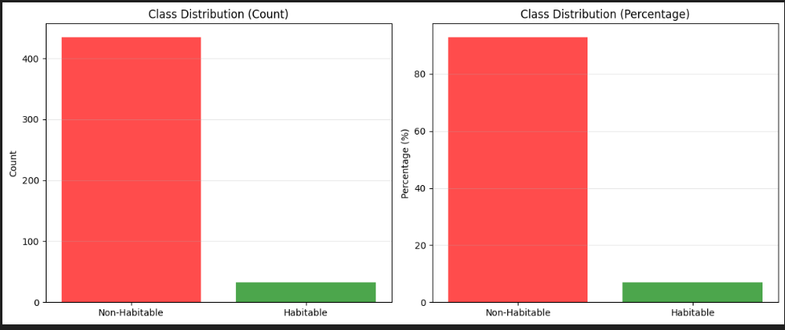
Imbalance Handling Techniques
SMOTE (Synthetic Minority Oversampling)
Borderline-SMOTE
SMOTE + Tomek Links
ADASYN
XGBoost
Goal: Improve recall for habitable
planets
Graph: Class Imbalance Analysis

Slide 11
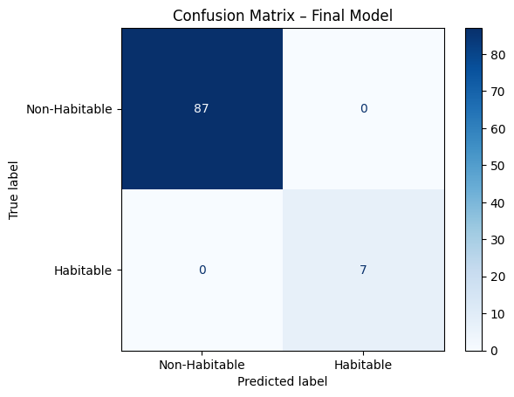
Pipeline-Based Modeling
Built end-to-end ML pipeline:
Scaling
SMOTE
Random Forest
Prevented data leakage
Ensured consistent preprocessing during inference

Slide 12
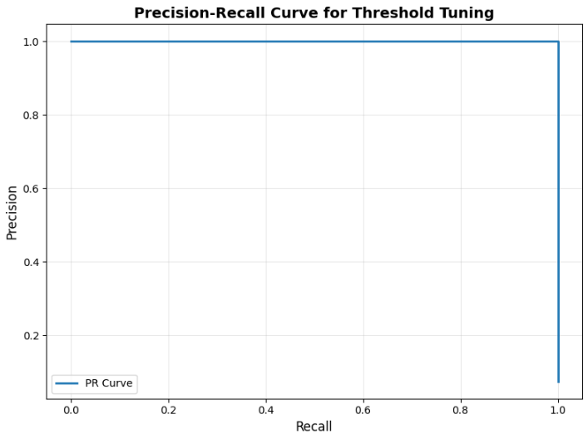
Model Evaluation
Used Stratified Train-Test Split
Cross-validation with StratifiedKFold
Precision-Recall Curve analysis
Decision threshold tuning for higher recall
Focus on minimizing false negatives

Slide 13
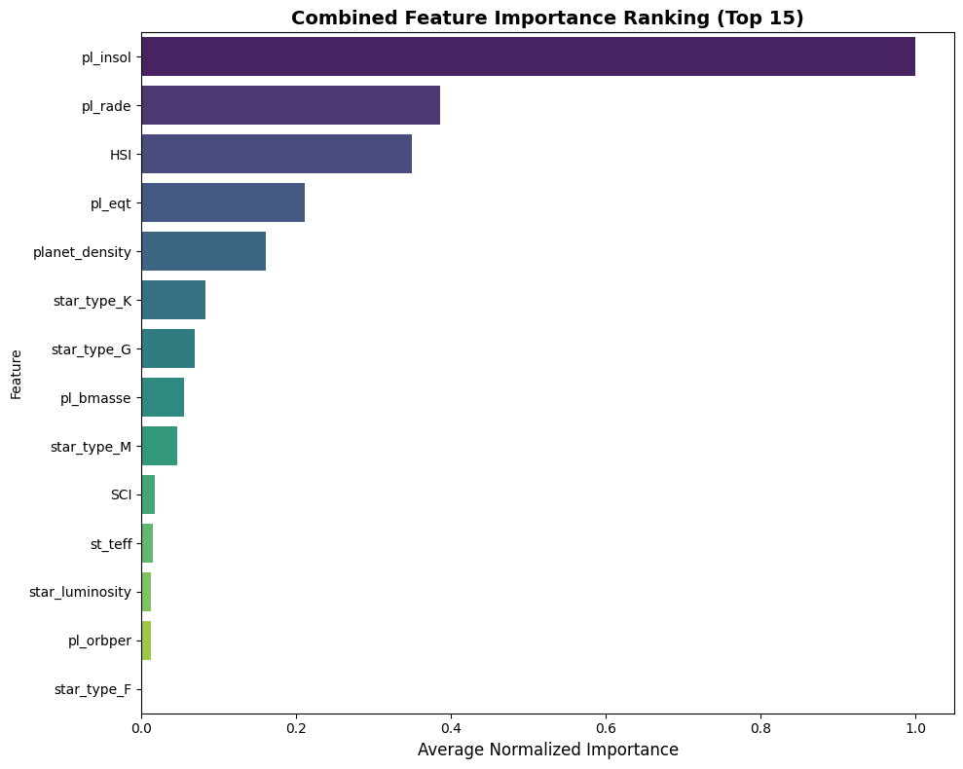
Feature Importance Analysis
Most influential features:
Insolation flux
Equilibrium temperature
Habitability Score Index (HSI)
Planet radius and density
Helps interpret model decisions
Provides scientific explainability

Slide 14
Results & Outcomes
Improved recall for habitable planets
Reduced false negatives after SMOTE
Stable model performance across folds
Ranked exoplanets by habitability probability
Identified top candidate habitable exoplanets

Slide 15
Deployment
BACKEND API DEVELOPMENT
FRONTEND INTERFACE
DEPLOYMENT
Built using Flask
REST endpoint /predict
Accepts planetary parameters in JSON format
Returns habitability prediction and probability
Model serialized using joblib
Implemented using Streamlit
Input form for planetary parameters
Displays prediction and probability
Connected to backend API
Backend deployed on Render
Frontend hosted via Streamlit
API tested using Postman
Logs used for debugging deployment issues

Slide 16
Future Scope and Conclusion
Future Scope:
Advanced visualization dashboard & Improved UI/UX
SHAP-based explainability
Inclusion of new exoplanet discoveries
Cost-sensitive learning approaches
Conclusion:
This project successfully demonstrates the application of machine learning to predict exoplanet habitability using real astronomical data. By combining domain knowledge, robust preprocessing, imbalance-aware modelling, and deployment, the system provides a practical and scalable habitability prediction framework.

Slide 17
PRESENTATION VIDEO
https://drive.google.com/file/d/1xTL1lKEiM0o0_fmTRpZBpsLLgkeHc5yq/view?usp=sharing

Slide 18
Any Questions??

Slide 19
THANK YOU

